Slide 1
LIVE EVENTS REVIEW APP use case by H & R Block
By
Ravali Bolem
Ashwini Gutha
Pranathi Gopidi
Satya Sai Deepthi Katta

Slide 2
INTRODUCTION
This application can be used by user to know about the events going on in the town an d also users can review about the on going events.
User to know about the live events in the town.
Users can review their comments on the event.
FEATURES:
User authentication is possible.
Users can know about the nearby events.
Users can give review about particular event.
ADVANTAGES:
User friendly interface
Good visualization

Slide 3
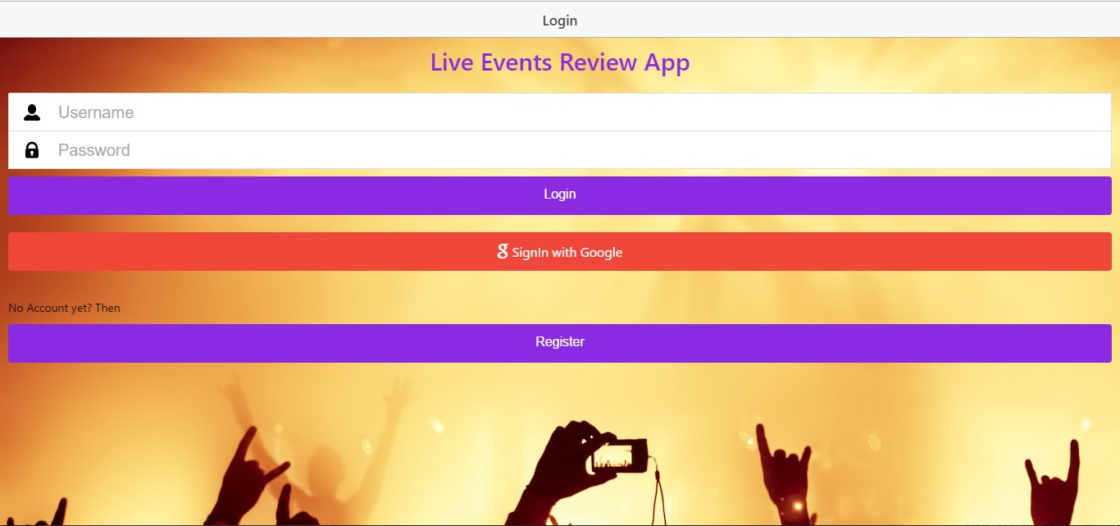
User Authentication

Slide 4
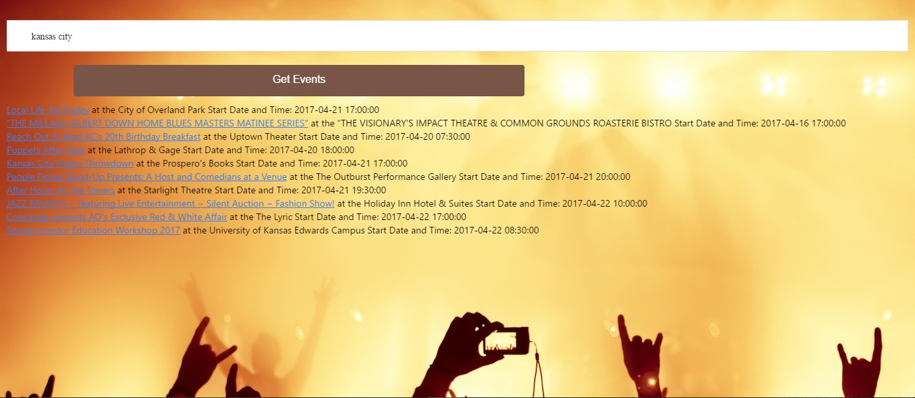
Events Near By

Slide 5
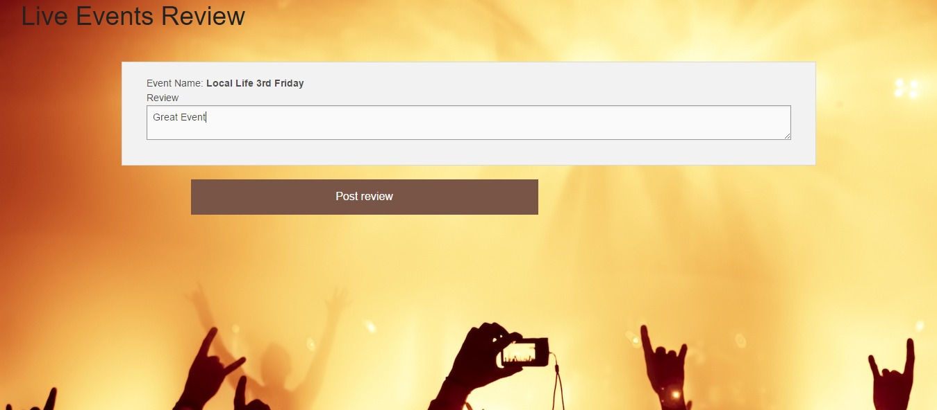
User Review about Event

Slide 6
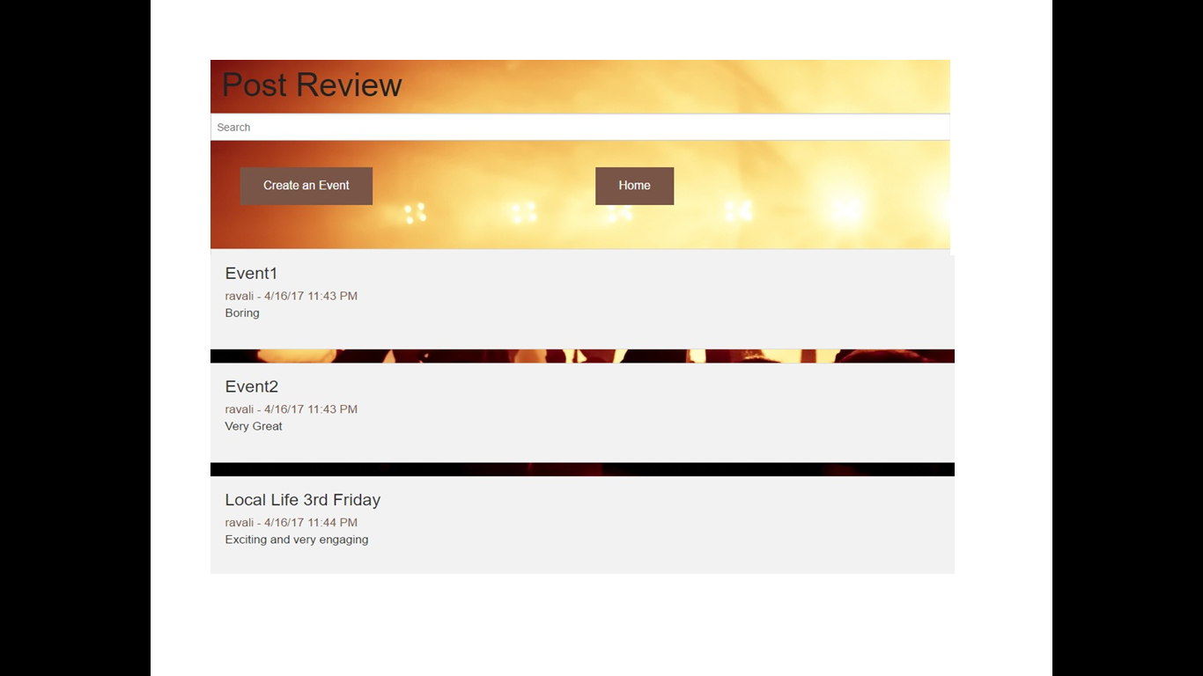
New Event Creation

Slide 7
THANK YOU

